Slide 1

RAG - POWERED CHATBOT ASSISTANT FOR PILOTS
Project Team Name : Flightlens
Professor : Clifford Whitworth
Final Project Presentation
Due Date : Nov 21, 2025
Team Members : Nivas Kapilavai Vishwanath
Nannapaneni Sai Bhavana
Naveed Shaik
Shivani Koyyada
Tirumala Teja Yegineni

Slide 2
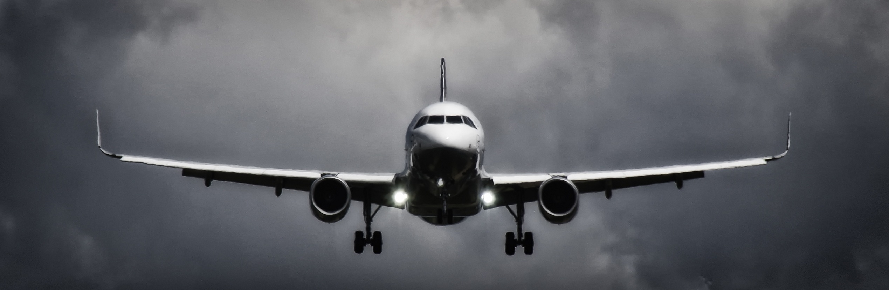
Introduction
Modern cockpits require rapid decision-making
Pilots rely on large manuals:
FAA Handbooks
FCOMs & QRHs
Checklists
METAR/TAF weather reports
Accessing this information in real time is slow
AI + NLP can reduce workload and improve safety
Aviation is a high-stakes environment — faster access to correct procedures can prevent accidents.

Slide 3
Research Problem
Can a Retrieval-Augmented Generation (RAG) system provide accurate, real-time, source-grounded procedural guidance to pilots?
Can RAG reduce manual search time for procedures?
How well does it interpret aviation terminology?
Does retrieval improve accuracy vs. standalone LLMs?
Can it integrate static manuals + dynamic weather data?

Slide 4
Research Objectives
Primary Objectives
Build an aviation-specific RAG pipeline
Retrieve verified content from FAA manuals & FCOMs
Generate accurate, traceable responses
Provide a usable cockpit-friendly interface

Slide 5
Research Objectives
Secondary Objectives
Integrate METAR weather decoding
Compare RAG vs BM25 baselines
Evaluate model accuracy using F1 & ROUGE
Enable basic voice interaction using Whisper

Slide 6
Literature Review
1. Retrieval-Augmented Generation
Shows retrieval improves factual accuracy
Reduces hallucination
Ideal for domains needing grounded answers
2. Human Factors in Aviation
AI must reduce cognitive load, not add to it
Trust and usability are key
3. Voice Interfaces in Noisy Environments
Highlights challenges of cockpit noise
Motivates robust ASR
Gap Identified:
No aviation-specific RAG system exists to provide real-time procedural support.

Slide 7
Data Sources
FAA Airplane Flying Handbook
FAA-H-8083-25C
Boeing 737 FCOM
Boeing QRH
A320 MMEL
Ryanair 737 FCOM
Live METAR feeds
Aviation glossaries

Slide 8
Tools & Libraries
Python, LangChain, FAISS, MPNet
Sentence-transformers
Whisper for transcription
Streamlit UI
Pandas, Numpy, PyPDF

Slide 9
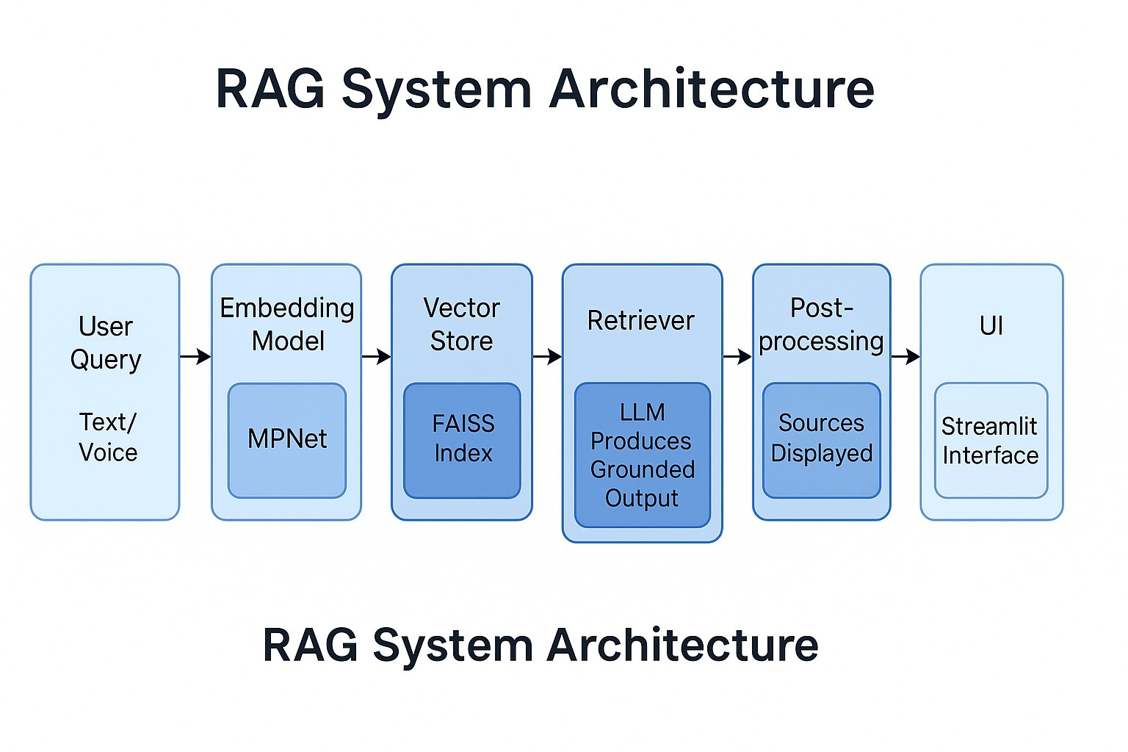
RAG System Architecture

Slide 10
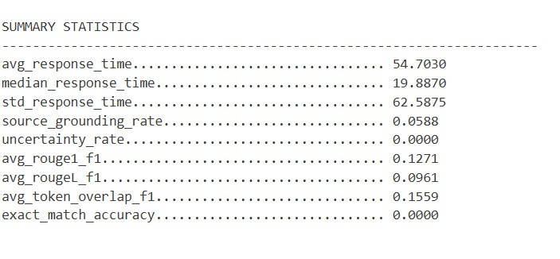
Results & Findings
Accuracy Metrics
Improved token F1 vs baseline
Higher ROUGE-1 & ROUGE-L
Better exact match accuracy
Strong retrieval precision using MPNet
Performance Findings
RAG reduced “hallucinations” significantly
Answers were traceable to manuals
METAR decoding yielded 100% correctness
Response speed within operational limits

Slide 11
Discussion
Key Insights
RAG is effective for technical, safety-critical domains
Vector retrieval ensures relevant procedure matching
The system aligns with prior work emphasising grounded AI
High reliability for structured queries (procedures, weather)
Interpretation
Confirms hypothesis: retrieval improves accuracy
Shows feasibility for cockpit decision support
Better performance than standalone LLMs or BM25

Slide 12
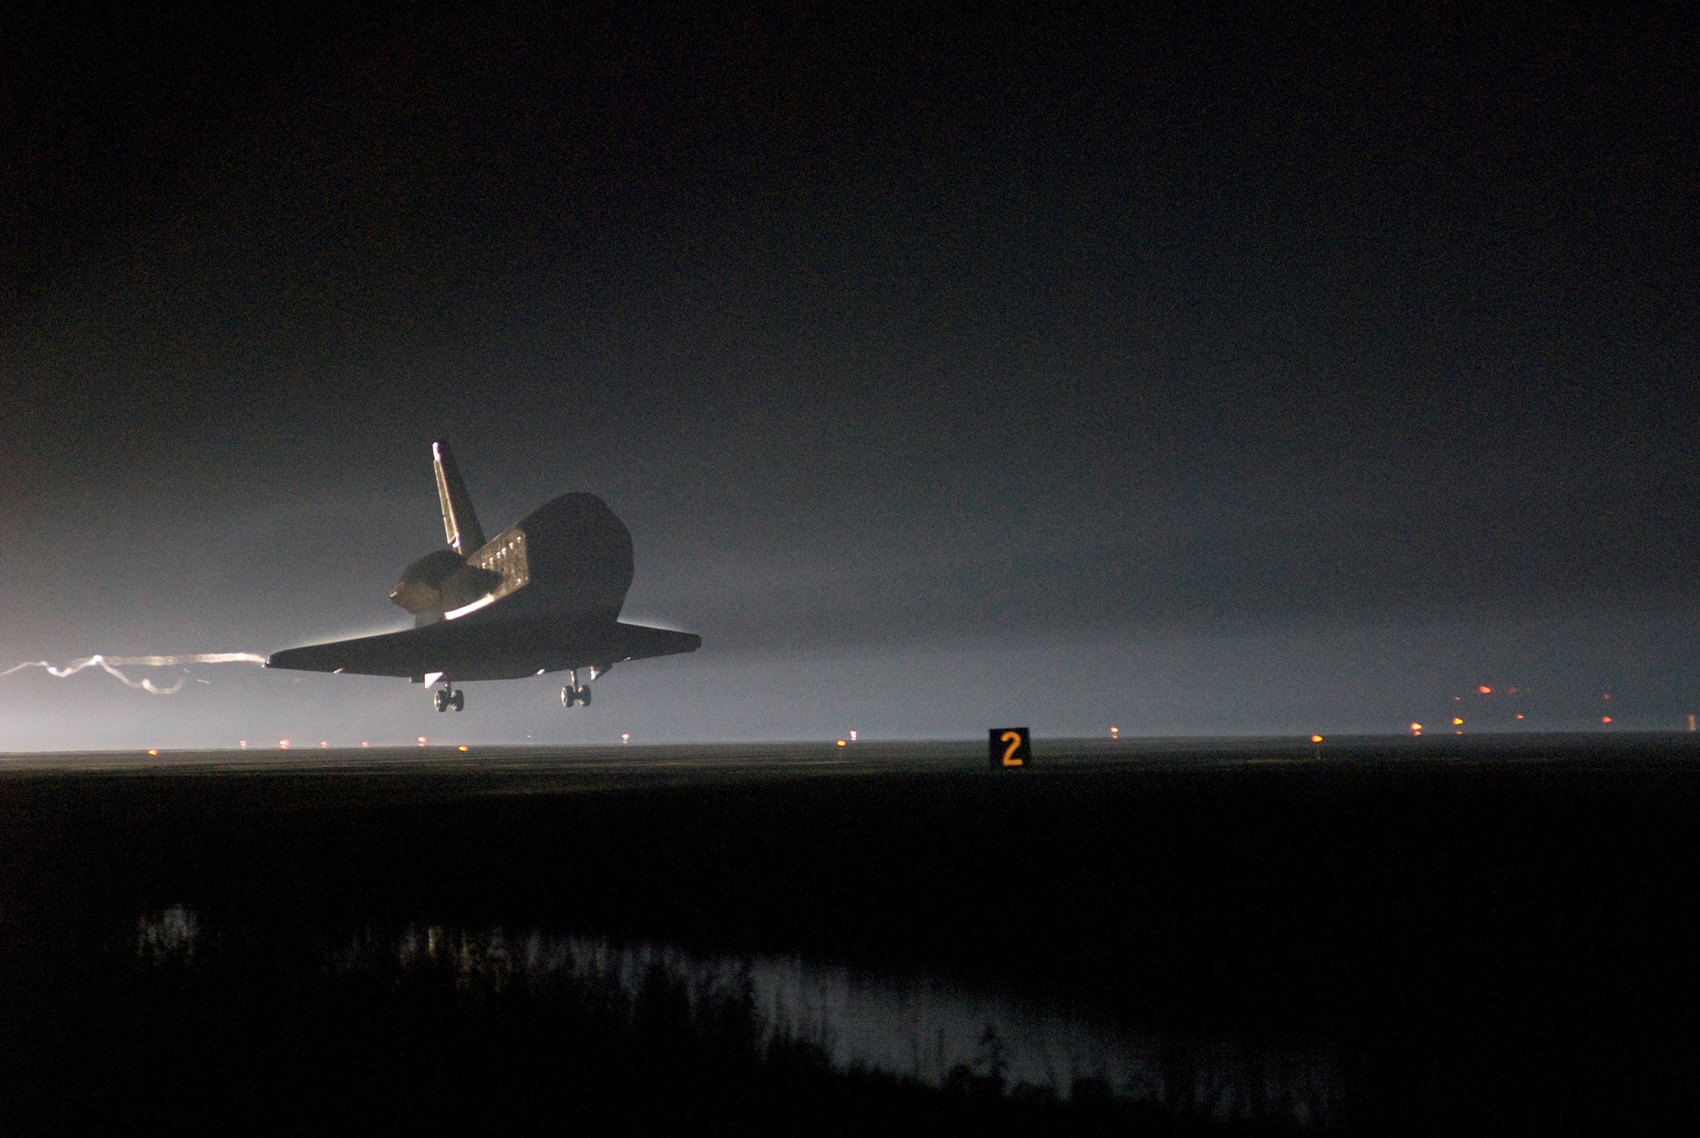
CONCLUSION
FlightLens successfully demonstrates a fully working aviation RAG system
Achieves accurate, grounded responses
Supports both text and voice queries
Integrates static & dynamic aviation data
Limitations
Limited training on noisy cockpit audio
Some manuals had formatting inconsistencies
LLM sometimes overly verbose

Slide 13
FUTURE RESEARCH
Add TAF/NOTAM data
Fine-tune domain-specific LLM
Improve ASR robustness
Build EFB/tablet-ready version

Slide 14
ACKNOWLEDGEMENTS
Professor Clifford Whitworth
FAA open resources
Boeing/Airbus technical documentation
UNT Python computing environment

Slide 15
THANK YOU

